Slide 1
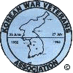
Introduction
Tell America
Purpose of Today’s Presentation
Background on the Korean War
Discussion of The War
Outcome of the War - In Perspective
Veteran Experiences
Notes:
Purpose of Today’s Presentation
Background on the Korean War
Discussion of The War
Outcome of the War - In Perspective
Veteran Experiences

Slide 2
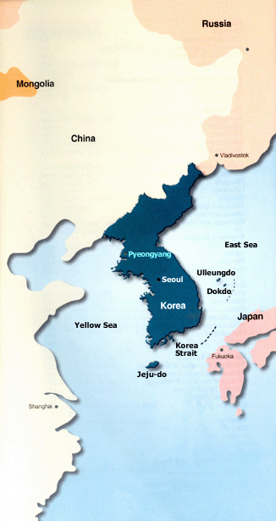
Tell America
Background of the Korean War
The Neighbors (whales)
Japan – China – Russia / USSR
Korea (the shrimp)
Hermit Kingdom
Ceded to Japan 1905
Japanese Annexation 1910-1945
Part of the Japanese Empire
Brutal Colonial Experience
Workers, Troops & Natural Resources for Japan
Notes:
Background of the Korean War
The Neighbors (whales)
Japan – China – Russia / USSR
Korea (the shrimp)
Hermit Kingdom
Ceded to Japan 1905
Japanese Annexation 1910-1945
Part of the Japanese Empire
Brutal Colonial Experience
Workers, Troops & Natural Resources for Japan

Slide 3
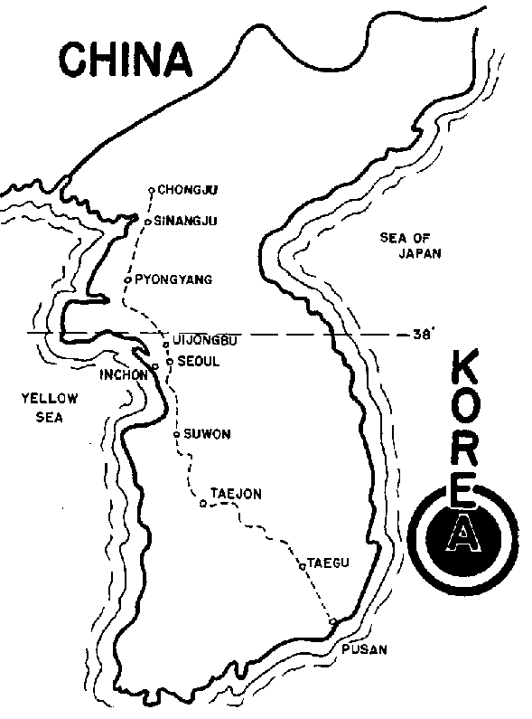
Tell America
Background of the Korean War (cont.)
End of World War II – Aug 15, 1945
Allied Occupation of Japanese areas
Yalta Agreement was basis
Soviets – Northern half of Korea
American – Southern half of Korea
Soviets and Americans withdraw 1948
Democratic People's Republic of Korea
Republic of Korea (ROK) – South Korea
Border Skirmishes, “Rice Raids” and political instability from 1945 leading up to 1950
Communist
North Korea
“Democratic”
South Korea
Notes:
Background of the Korean War (cont.)
End of World War II – Aug 15, 1945
Allied Occupation of Japanese areas
Yalta Agreement was basis
No real plan or understanding of Korea
38th Parallel was dividing line
Soviets – Northern half of Korea
American – Southern half of Korea
Soviets and Americans withdraw 1948
Democratic People's Republic of Korea (DPRK) – North Korea
Republic of Korea (ROK) – South Korea; 15 Aug. 1948
Border Skirmishes, “Rice Raids” and political instability

Slide 4
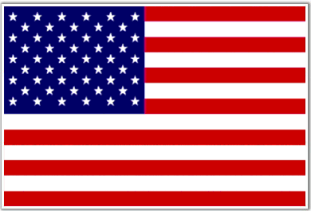
Tell America
Communist
North Korea
Background of the Korean War (cont.)
Korea In the Cold War
USSR puts Kim Il-Sung in power in NK
Stalin thinks ROK is “outside” US sphere
Communists Win Civil War in China ‘49
Chinese – Soviet Relations
Americans want out of South Korea
Removes Combat Troops in 1949
Korean Military Advisory Group - KMAG
500 advisors; limited weapons
no tanks, artillery or aircraft
South Korean Constabulary protects borders
Border Skirmishes, “Rice Raids” and political instability from 1945 leading up to 1950
“Democratic”
South Korea
Notes:
Background of the Korean War (cont.)
End of World War II – Aug 15, 1945
Allied Occupation of Japanese areas
Yalta Agreement was basis
No real plan or understanding of Korea
38th Parallel was dividing line
Soviets – Northern half of Korea
American – Southern half of Korea
Soviets and Americans withdraw 1948
Democratic People's Republic of Korea (DPRK) – North Korea
Republic of Korea (ROK) – South Korea; 15 Aug. 1948
Border Skirmishes, “Rice Raids” and political instability

Slide 5
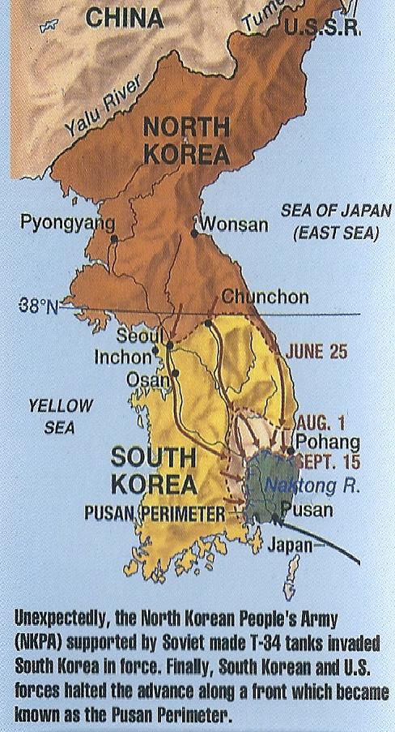
Tell America
Outbreak of Korean War
June 25, 1950
North Korean surprise attack
Russian-made T-34 Tanks, Artillery
Swept south quickly; captures Seoul
Birth of the ROK Army in war
American supports South Korea
Air, Naval and Ground forces
Task Force Smith – July 1950
ROK Army & Americans withdraw
Fighting retreat to “Pusan Perimeter”
NKPA stretched thin; hard fighting
US and UK troops arrive

Slide 6
Tell America
United Nations Responses
June 25, 1950 – UN Resolution 82:
determined that this action constituted a breach of the peace and called for the immediate cessation of hostilities, with the North Koreans withdrawing.
June 27, 1950 – UN Resolution 83:
observed North Korea's failure to comply with Security Council Resolution 82 and that urgent military measures were required to restore international peace and security.
July 7, 1950 – UN Resolution 84:
recommended that the members of the United Nations furnish such assistance to the Republic of Korea as may be necessary to repel the attack and restore peace and security to the area.
The Soviet Union was absent and did not vote; Communist China was not a UN member nation and had no standing

Slide 7
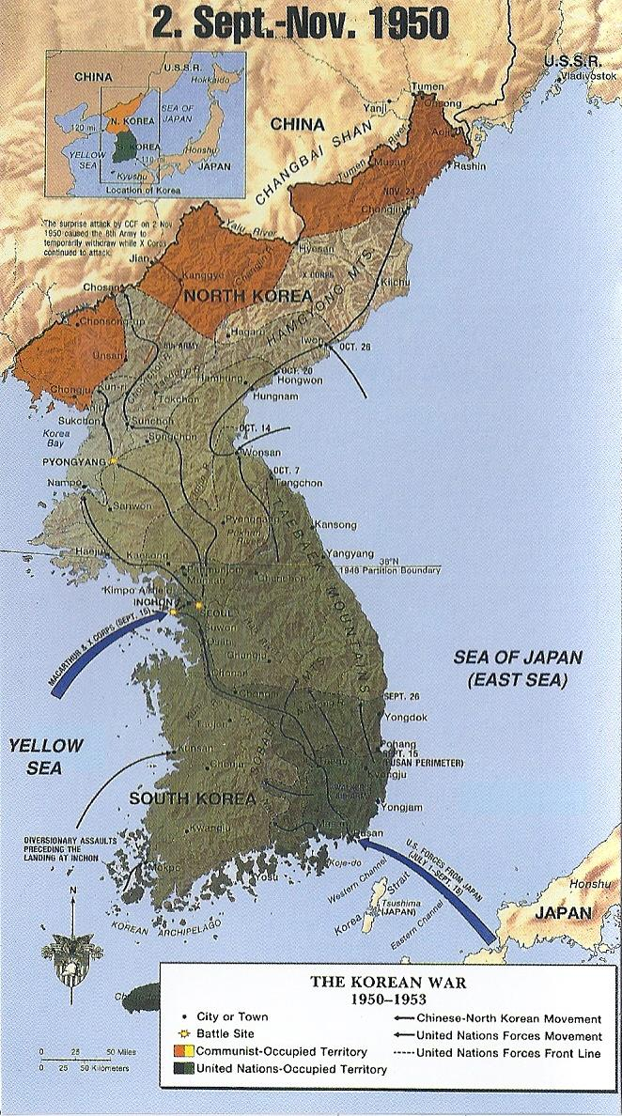
Tell America
Inchon and Breakout
Sept. 15, 1950
US troops land at Inchon
NKPA stretched thin and beaten
US, UK & ROK troops surge north from Pusan Perimeter
NKPA collapses and retreats
Seoul liberated September 1950
ROK Army crossed 38th Parallel Oct. 1, 1950; US/UN forces Oct. 7, 1950
Communist Chinese send indirect messages of concern over the “Korea question.”
The “Peoples’ Volunteer Army” formed from Chinese Communist Forces (CCF)
300,000 CCF troops march undetected into North Korea, beginning in Oct. 1950
US, UN and ROK troops advance to the Yalu River

Slide 8
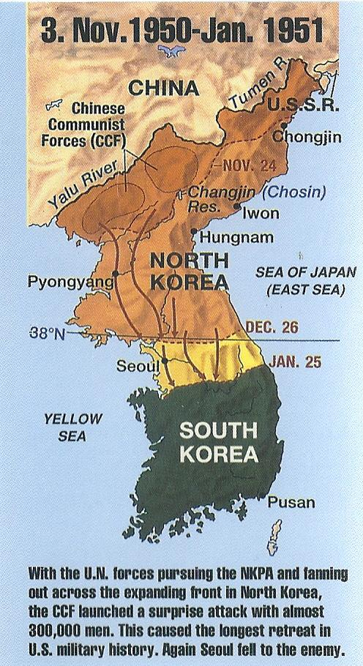
Tell America
Chinese Intervention
Nov. 3, 1950
North Korean Army beaten
US/UN/ROK forces near China
CCF masses 300,000 troops and attacks in very bitter winter weather
USMC / Army at Chosin Resevoir a fighting retreat thru Dec. 1950
UN Forces retreat south; many losses
US 8th Army CG Walker dies; Gen. Ridgeway takes over
Seoul evacuated by UN forces CCF & NKPA occupy
Gen Ridgeway revitalizes US & UN Forces
CCF and NKPA unable to push forward – supplies, ammunition and manpower limited

Slide 9
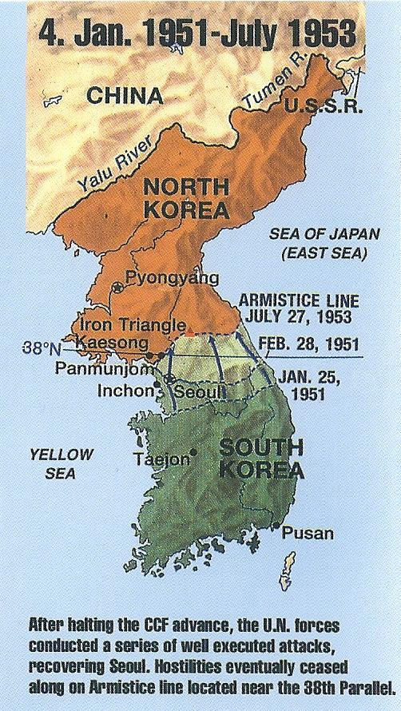
Tell America
War of Attrition – the Long Fight
CCF and NKPA advance was stopped
UN Forces launch Operations Ripper and Killer – focus on destroying CCF / NKPA forces
Terrain and weather are harsh
Seoul liberated March 14-15 by ROK 1st Division and US 3rd Infantry Division
April 3, 1951, UN forces cross 38th Parallel; MacArthur relieved, April 11; Ridgeway appointed UN Commander
UN Forces grind north, taking more terrain
July 10, 1951 Armistice Talks Begin at Kaesong, a North Korean-controlled city

Slide 10
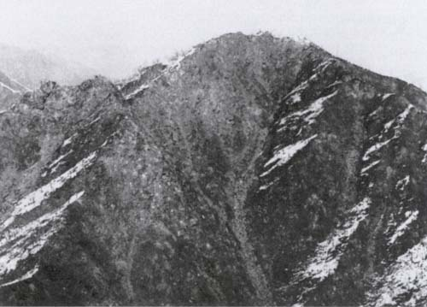
Tell America
War of Attrition – King of the Hill
Fighting continues until June 13, 1951 – UN forces hold, pending Armistice Talks – skirmishes and patrol actions
CCF and NKPA use the Armistice for propaganda and to buy time to rearm and prepare
Communists quit talks in August 1951 over an “insult”
UN Operations –the “Hill Fights” begin Heartbreak Ridge, the Punchbowl, Capitol Hill, The Hook, White Horse Mountain , put pressure on CCF leaders
Operation Summit a US Marine infantry company transported by helicopters, captures a hilltop, establishing a combat outpost – 1st use of helicopters for combat deployment - Sept 13, 1951
Armistice Talks and Fighting grind on through 1953, with the talks at Panmunjon, between the forces.

Slide 11
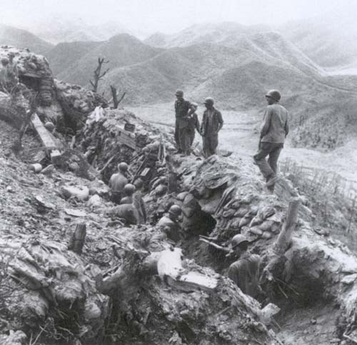
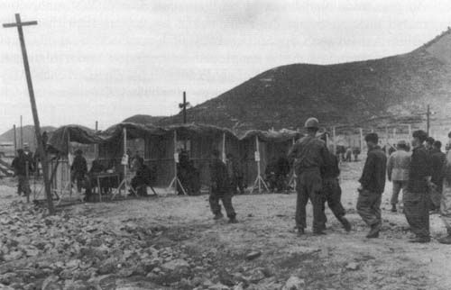
Tell America
War of Attrition – Summer of 1953
CCF and UN Forces continue the “King of the Hill” fighting.
US and UN forces limit combat operations, balancing losses against gains.
Armistice is stalled due to Prisoner of War Question and Communist demands that all POWs are returned.
US/UN will not forcibly repatriate POWs who do not want to go to Communist China or North Korea.
7th Infantry Division trenches, July 1953
(National Archives)
On June 13, 1953, Communist agree POWs terms – voluntary repatriation under control of neutral powers
CCF attacks to put pressure on UN and ROK forces Outposts Tom, Dick and Harry break CCF attacks; ROK Army punished at Kumwah
July 27, 1953 – Armistice signed by CCF, NK, US & UN representatives’ ROK refuses
Fighting ends and a Demilitarized Zone (DMZ) is created between the armies.
Repatriation screening of Communist POWs. 1952
(National Archives)

Slide 12
Tell America
Interesting aspects of the Korean War
A “limited” war in the context of the Cold War
First war where American troops were racially integrated
First “Jet War” involving air combat between jet fighters
First war where Helicopters were used in operations
Major advancements in Military Medicine – MASH – Mobile Army Surgical Hospital

Slide 13
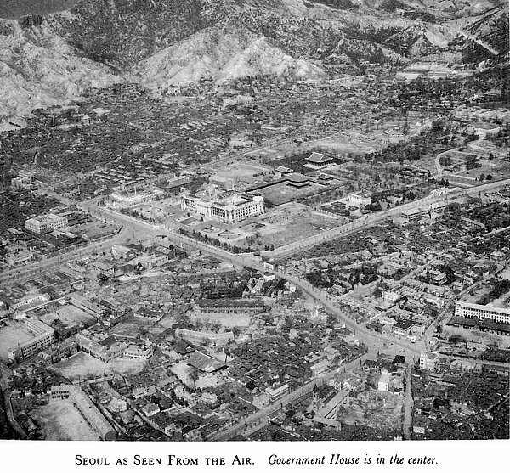
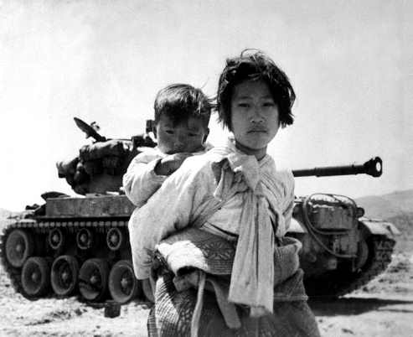
Tell America
The Aftermath
The War ended with North Korea Communist and South Korea a democracy
Both countries suffered horrible costs – millions dead, homes, factories and infrastructure destroyed or damaged.
The UN successfully defended a member state and avoided a wider war
Cost billions of dollars, yet saved a people
US: 36,700 dead; 97,000 wounded; 8,176 MIA, 7,245 POW
ROK: 137,899 dead, 450,000 wounded,
32,838 MIA or POW
UN Forces: 3,407 dead; 12,705 wounded; 1,796 MIA; 1,376 POW
NKPA: 215,000 dead; 303,000 wounded; 120,000 MIA or POW
CCF: 183,108 dead; 383,000 wounded; 25,621 MIA; 21,400 POW

Slide 14
Tell America
The Aftermath
The War ended with North Korea Communist and South Korea a democracy
Both countries suffered horrible costs – millions dead, homes, factories and infrastructure destroyed or damaged.
The UN successfully defended a member state and avoided a wider war
Cost billions of dollars, yet saved a people
US: 36,700 dead; 97,000 wounded; 8,176 MIA, 7,245 POW
ROK: 137,899 dead, 450,000 wounded,
32,838 MIA or POW
UN Forces: 3,407 dead; 12,705 wounded; 1,796 MIA; 1,376 POW
NKPA: 215,000 dead; 303,000 wounded; 120,000 MIA or POW
CCF: 183,108 dead; 383,000 wounded; 25,621 MIA; 21,400 POW

Slide 15
Tell America
One Veteran’s Perspective
Where and When I served
What I carried and Wore
What I remember the best
What I think of Korea today?
What I hope comes out of my sharing my Korean War experience.

